Slide 1
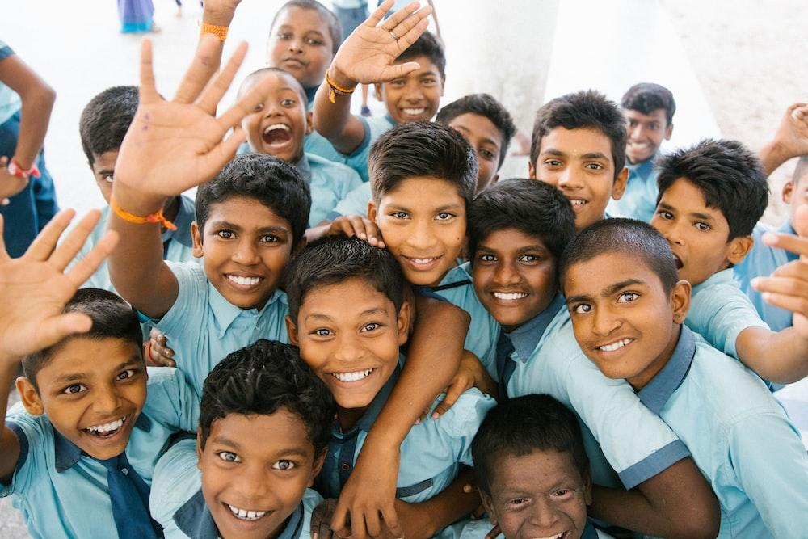
Case Management

Slide 2
Definition of Case Management
01
Transforming lives through individualized care and services so children and families can meet their goals
@Miracle Foundation 2021

Slide 3
Child-Centered Case Management
02
Purpose:
Consistent and on-going support to child and family through each step of the process
Documentation of assessments and records to develop care plans and make sound decisions regarding reintegration
Core Values:
Engage children in appropriate ways at each step
Protect children from harm
Ensure that decisions are made in their best interests
image: Stock Photos
@Miracle Foundation 2021

Slide 4
Case Manager
03
In places where very few professional social workers are available, lay people such as community leaders/members can be trained to act as case managers.
Professional responsible for coordinating the overall care delivered to children and families following a systematic case management process.
Case Managers work with family members, friends, educators, psychologists, health care experts, and others involved in the child’s life to meet the needs of each child.
This professional must have:
the ability to develop trusting relationships with the children and families
a solid understanding of the community, cultural customs, local language
@Miracle Foundation 2021

Slide 5
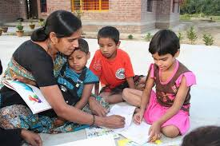
Principles of Case Management
04
Do No Harm
Prioritize the Best Interests of the Child
Ensure Accountability – take responsibility for your actions
Based on Sound Knowledge of Child Development and Child Rights
Child’s Right to be Heard, Participate, and their Views
taken Seriously – involve children and seek out their
opinions
Provide Culturally Appropriate Processes and
Services
Seek Informed Consent
Respect Confidentiality
Work in Non-discriminatory Way
Maintain Professional Boundaries
image: Stock Photos
@Miracle Foundation 2021

Slide 6
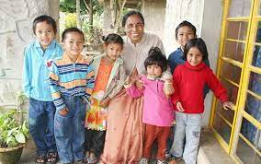
Case Management Plan
05
A comprehensive care plan for a child that describes:
Child’s and family’s strengths, challenges, needs, and desires as determined from the child and family assessments
Plans for support and interventions to be implemented
Measurable goals, time frames to achieve them, and resources to be used
image: Stock Photos
@Miracle Foundation 2021

Slide 7
Case Management Process
06
Intake/ Admission
Follow-Up/ Evaluate
Close Case
Assess
Plan
Implement
The process is highly individualized and focused on the child.
Note that the process is presented as steps, but it is often non-linear and can involve several steps happening at the same time or circling back in the process.
@Miracle Foundation 2021

Slide 8
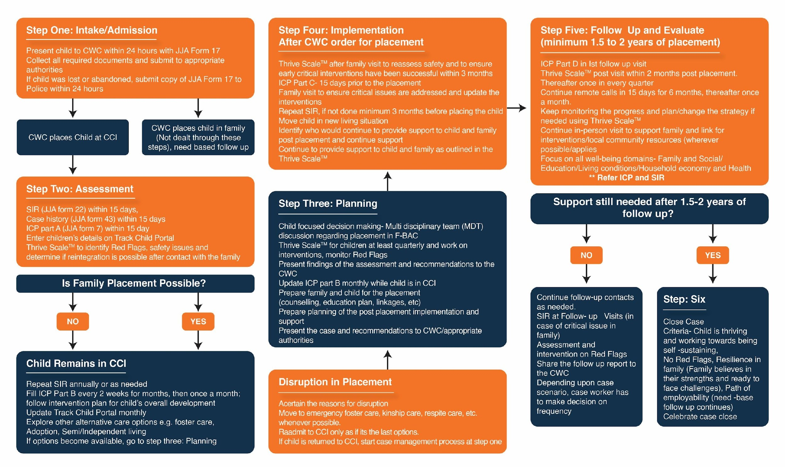
Case Management flow Chart
07
@Miracle Foundation 2021

Slide 9
Meet Riya
08
We will use a fictional case study of a child to walk through the steps of case management.
Riya is a 6 year old girl who is entering Caring Child Care Institution (CCI) because her father recently passed away, and her mother, a domestic worker, can’t take care of Riya on her own because her work keeps her away from home.
Riya’s mother passes Caring CCI on her way to work every day and sees all the children getting ready for school. She decided it would be the best place for her daughter at this time since Riya would get the basics of food and clothing, they could support her education, and she would get good care outside of school hours.
Though it was a really difficult decision, Riya’s mother felt it was the best option she had for Riya to get the care she needed. She told Riya about her plan and asked her to pack up a few items, since she would be dropping Riya off on her way to work the next day.
@Miracle Foundation 2021

Slide 10
Step One: Intake/Admission
09
Riya is not able to return immediately to her family home so short-term placement was needed in a CCI until her family situation could be strengthened.
When Riya arrived at Caring CCI, the staff took the following steps:
Looked for concerns that needed to be addressed immediately such as health issues, signs of abuse, etc.
Collected all required documents and presented to the appropriate authorities (India: JJA Form 17 to CWC within 24 hours)
If Riya had been lost or abandoned, they would have notified police or other authorities (India: CCI must submit Form 17 to local police)
Determined immediate, short-term placement into CCI
@Miracle Foundation 2021

Slide 11
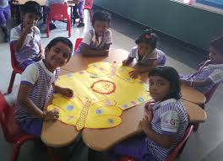
Step Two: Assessment
10
Once the Intake process was completed, the Caring CCI Case Manager turned her focus to understanding more about Riya’s strengths and challenges in all of the child development areas, as well as learning about her family’s current situation.
This process included:
Identifying Riya’s interests, concerns, needs, strengths, and her support system Collaborating with family members and professionals in Riya’s life (health, education, mental health, etc.)
Completing a comprehensive child care plan to address her needs and identify potential interventions India: Child Case History - JJA Form 43 and Individual Care Plan (ICP) – JJA Form 7 within one month
Assessing the safety of the family environment through Red Flag items identified on the Home Thrive ScaleTM
Determining if reintegration is possible after contact with family India: Social Investigation Report – JJA Form 22 within 15 days
image: Stock Photos
@Miracle Foundation 2021

Slide 12
Step Three: Planning
11
Armed with knowledge about Riya’s and her family’s strengths and challenges, the case manager turned to child-focused decision making and service planning to address Riya’s and her mother’s needs.
She utilized the Home Thrive ScaleTM to provide a clearer picture of services needed to
surround Riya with security and an opportunity to thrive in her family home.
It was determined that Riya’s mom could support her if childcare was made available while she was at work, and emotional support was provided to both regarding the loss of their father/husband.
The Home Thrive ScaleTM outlines:
Riya’s and her mom’s thoughts about living together once again
Needs and strengths of Riya and her mom, and services required
Extended family, community members, organizations that could provide support so Riya can stay home
Specific, measurable, and time-bound goals that will be monitored
A plan for permanency, so Riya can be confident that her family home is her forever home
@Miracle Foundation 2021

Slide 13
Step Four: Implementation
12
The case manager found that Riya’s aunt could care for her outside of school hours if transportation could be provided to her home. The case manager was able to recruit several families with children in the same school as Riya to help with transportation issues. The case manager also arranged for Riya and her mother to receive grief counseling to help them through this difficult time after the loss of their father and husband.
Now that a determination has been made regarding reintegration for Riya, it is time for the Case Manager to coordinate the implementation of support and follow the progress. This includes:
Preparing Riya and her mom for her return – working through emotions related to the separation and reunification
Linking them to their support network and community services
The case manager keeps Riya and her mom involved and updated throughout the process.
@Miracle Foundation 2021

Slide 14
Step Five: Follow-Up
13
Riya and her mother are active participants in evaluating the support they receive. Riya is enjoying school and her mom feels more ready to take on responsibility knowing she has people to reach out to. Together, they celebrate successes and voice their concerns when they face a challenge.
The Case Manager must connect with Riya and her mother frequently. The primary objective is to ensure that they are finding the support helpful, to understand any issues or concerns, and to revise the care plan as needed.
Regular calls and visits by the Case Manager as well as from kin and
community members assure Riya and her mom that they are not alone.
Conversations with teachers, healthcare providers offer additional insight into
the family’s adjustment
The Home Thrive ScaleTM should be completed at every follow up contact, and plans should be modified as needed to help Riya and her mother build upon their strengths and continue to develop their coping skills.
Adjustment and settling back in takes time, and the Case Manager is there to help Riya and her mother through the process as they work to achieve their goals.
@Miracle Foundation 2021

Slide 15
Home Thrive ScaleTM
14
The Home Thrive Scale is available in paper form or as an automated version accessible by cell phone or tablet.
Ensures serious Safety concerns (RED FLAGS)* related to reintegration are addressed as a priority
Allows us to track the quality of the family’s reintegration over time.
Family’s wellbeing is assessed under 5 domains:
Family and Social Relationships
Household Economy
Living Conditions
Education
Health and Mental Health
Milestones under each right are rated on a scale of 1 (in crisis – needs immediate attention) to 4 (thriving – no attention needed)
Detailed intervention plans are created for each milestone that needs attention
Progress is tracked by domain over time
@Miracle Foundation 2021

Slide 16
Graphing Results of the Home Thrive ScaleTM
15
Riya and her mother had a pre- reintegration score of 89% in Household Economy due to lack of access to childcare. Now that Riya’s aunt is providing that care, the score has improved to 100%.
Family & Social Relationships 100%
90%
80%
70%
60%
50%
40%
In addition, both Riya and her mom were grieving the loss of their father/husband, and it was impacting the relationship between them and Riya’s ability to concentrate at school. Bolstered by grief counseling, their Family and Social Relationships and Health/Mental Health domains improved significantly.
Health & Mental Health
30%
20%
10%
0%
Household Economy
Education
Living Conditions
Goal = 100%
Pre-Reintegration
At Reintegration
6 Month Follow-Up
Finally, the Living Conditions domain improved due to a safer home environment for Riya.
@Miracle Foundation 2021

Slide 17
Step Six: Close Casea
16
Cases are typically closed because:
Goals of the plan have been met and long-term care is assured
Permanency goal has been met
Child can successfully live independently at age 18
Care of child has been transferred to another agency or organization
Even after closure, the child and family should always know who to reach out to for assistance in the future.
Riya and her mother have been happily living together once again for over a year. They still have some growth they would like to accomplish, so the Case Manager is still there to support them. They have noted that now that they are feeling stronger, they would like to help others in their community as they work through difficult situations.
@Miracle Foundation 2021

Slide 18
Thank You

